Slide 1

Model Preparation
Data Extraction
- Data out of (Q1 – factor * IQR, Q3 + factor * IQR) are defined as outliers
- The factor is set to 5, because it can maintain only 5% data were dropped
Model Selection
- Traditional Method: Random Forest, KNN, Gaussian NB, Multinomial NB
- Neural Network
Data Splitting
- test: train = 2: 8( for traditional model)
- test: validate: train = 2: 2: 6( for Neural Network Model)

Slide 2
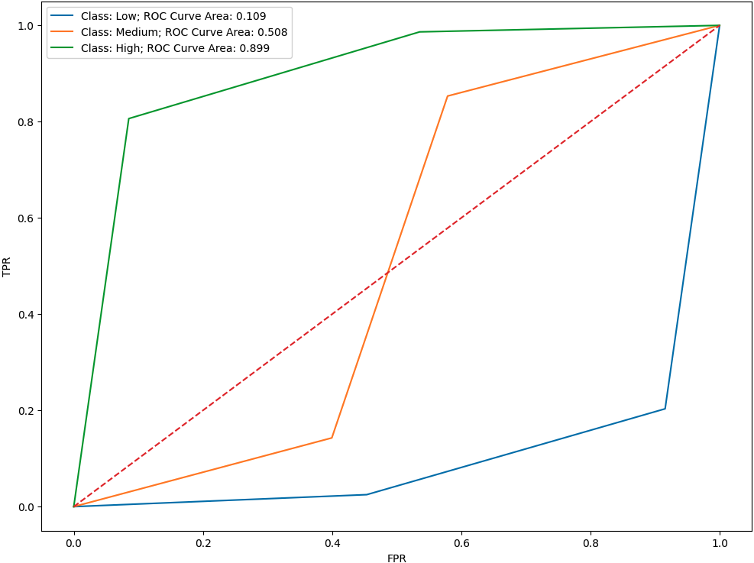
Random Forest Result
Accuracy:
Confusion Matrix:
77 %
 | 0 | 1 | 2
0 | 192 | 43 | 6
1 | 37 | 179 | 36
2 | 3 | 40 | 179
Classification Report
ROC curve
 | Precision | Recall | F1-Score | Support
0 | 0.83 | 0.8 | 0.81 | 241
1 | 0.68 | 0.71 | 0.7 | 252
2 | 0.81 | 0.81 | 0.81 | 222
accuracy |  |  | 0.77 | 715
Macro avg | 0.77 | 0.77 | 0.77 | 715
weighted avg | 0.77 | 0.77 | 0.77 | 715

Slide 3
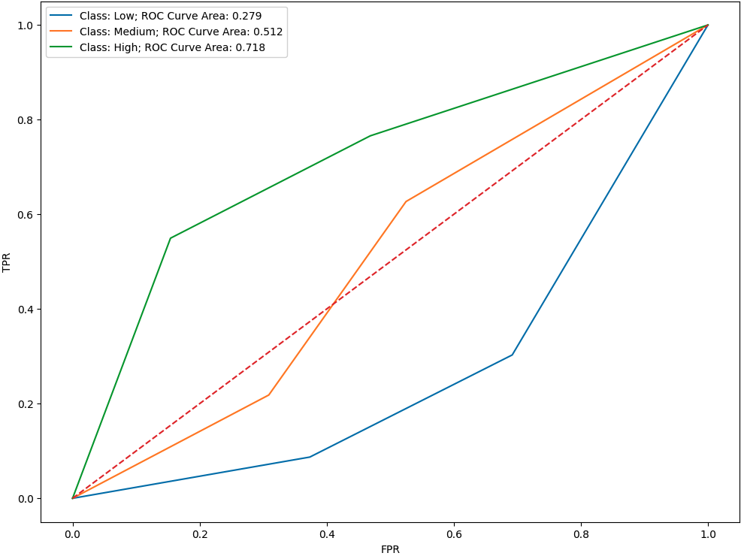
K Neighbors Result
Accuracy:
Confusion Matrix:
55 %
 | 0 | 1 | 2
0 | 168 | 52 | 21
1 | 94 | 103 | 55
2 | 52 | 48 | 122
Classification Report
ROC curve
 | Precision | Recall | F1-Score | Support
0 | 0.54 | 0.7 | 0.61 | 241
1 | 0.51 | 0.41 | 0.45 | 252
2 | 0.62 | 0.55 | 0.58 | 222
accuracy |  |  | 0.55 | 715
Macro avg | 0.55 | 0.55 | 0.55 | 715
weighted avg | 0.55 | 0.55 | 0.54 | 715

Slide 4
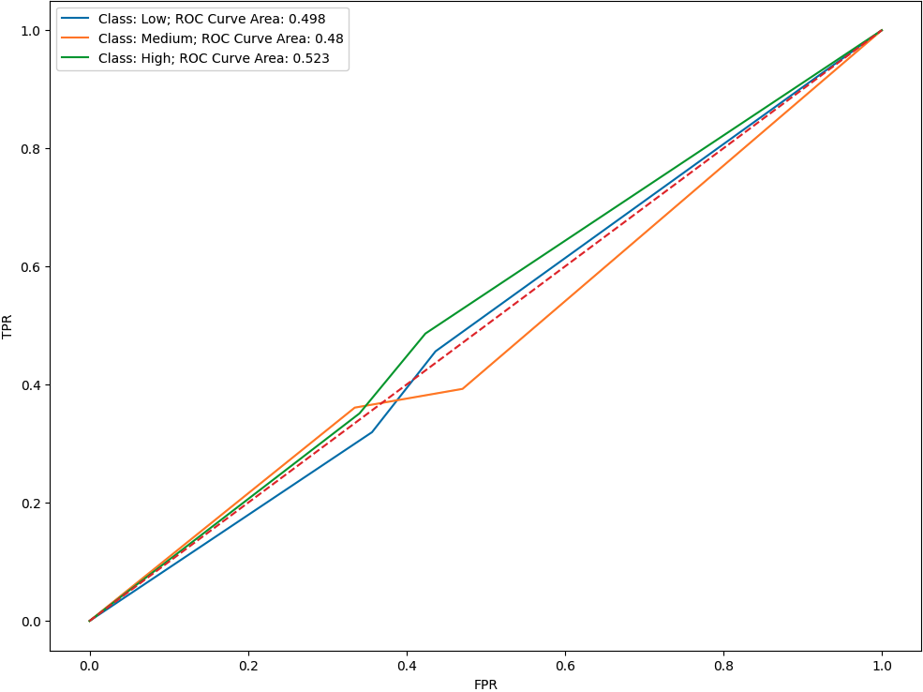
Multinomial NB Result
Accuracy:
Confusion Matrix:
30 %
 | 0 | 1 | 2
0 | 131 | 33 | 77
1 | 153 | 8 | 91
2 | 114 | 30 | 78
Classification Report
ROC curve
 | Precision | Recall | F1-Score | Support
0 | 0.33 | 0.54 | 0.41 | 241
1 | 0.11 | 0.03 | 0.05 | 252
2 | 0.32 | 0.35 | 0.33 | 222
accuracy |  |  | 0.30 | 715
Macro avg | 0.25 | 0.31 | 0.26 | 715
weighted avg | 0.25 | 0.30 | 0.26 | 715

Slide 5
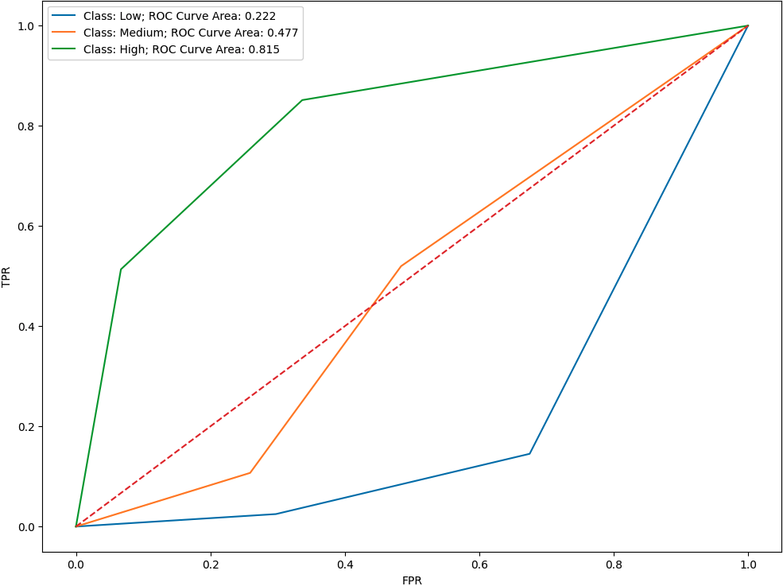
Gaussian NB Result
Accuracy:
Confusion Matrix:
59 %
 | 0 | 1 | 2
0 | 206 | 29 | 6
1 | 121 | 104 | 27
2 | 33 | 75 | 114
Classification Report
ROC curve
 | Precision | Recall | F1-Score | Support
0 | 0.57 | 0.85 | 0.69 | 241
1 | 0.5 | 0.41 | 0.45 | 252
2 | 0.78 | 0.51 | 0.62 | 222
accuracy |  |  | 0.59 | 715
Macro avg | 0.62 | 0.59 | 0.59 | 715
weighted avg | 0.61 | 0.59 | 0.59 | 715

Slide 6
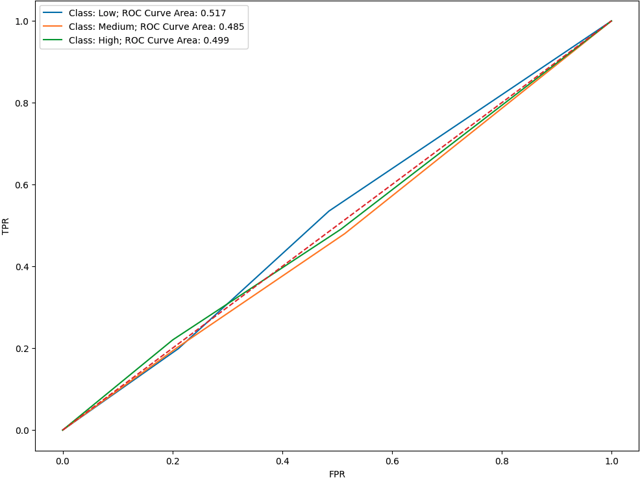
Neural Network Result
Accuracy:
Confusion Matrix:
32 %
 | 0 | 1 | 2
0 | 112 | 81 | 48
1 | 131 | 70 | 51
2 | 113 | 60 | 49
Classification Report
ROC curve
 | Precision | Recall | F1-Score | Support
0 | 0.31 | 0.46 | 0.38 | 241
1 | 0.33 | 0.28 | 0.30 | 252
2 | 0.33 | 0.22 | 0.26 | 222
accuracy |  |  | 0.32 | 715
Macro avg | 0.33 | 0.32 | 0.31 | 715
weighted avg | 0.33 | 0.32 | 0.32 | 715

Slide 7
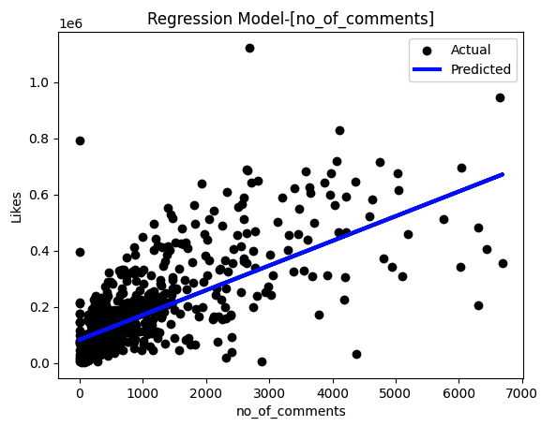
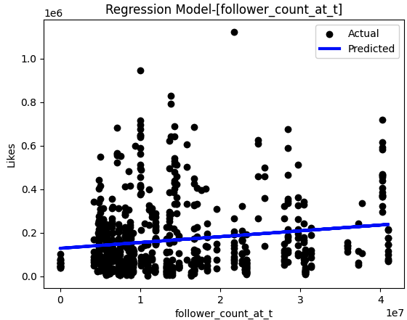
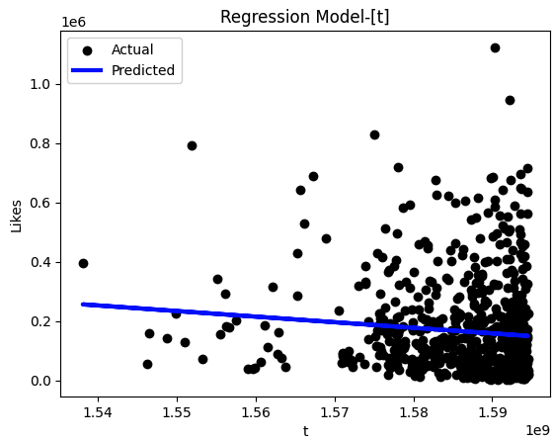
Appendix- Regression Result
Regression Scatterplot for single linear regression
mse and r2 for different composition of parameters
 | c | t | f | c + f + t | c + f | c + t | t + f
mse | 1.257e+10 | 2.662e+10 | 2.640e+10 | 1.227e+10 | 1.244e+10 | 1.242e+10 | 2.607e+10
r2 | 0.532596 | 0.010561 | 0.018915 | 0.543833 | 0.537570 | 0.538202 | 0.031093
c: no_of_comments
f: follower_count_at_t
t: t

